Slide 1
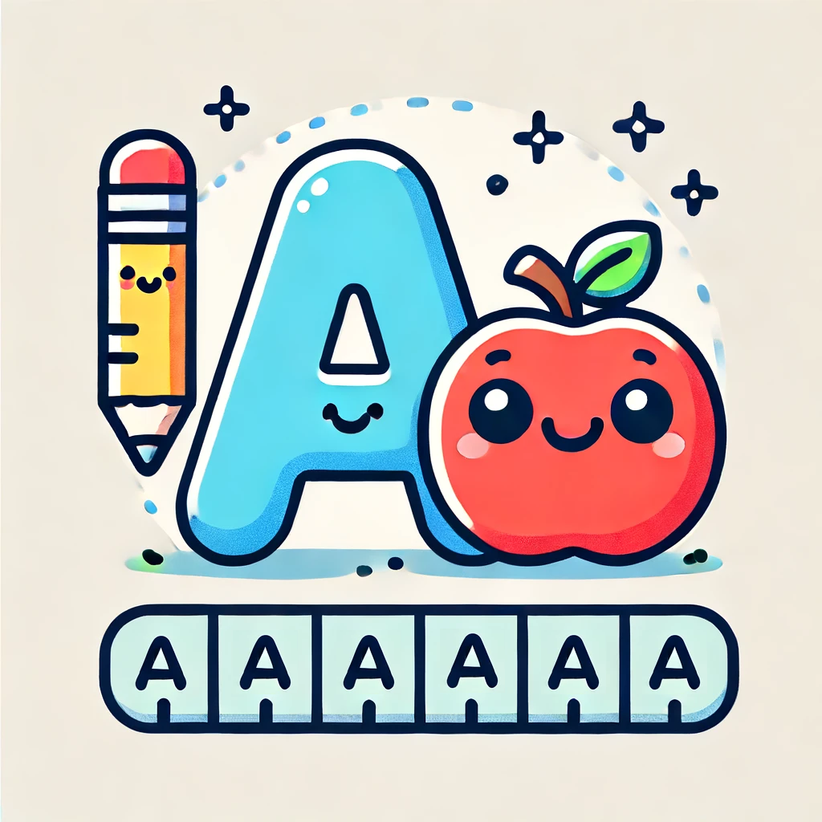
Introduction
Letters ABC
Let your kid learn letters ABC with the story
Age: 5-7
Time: 5 min
Pages: 6
Start

Slide 2
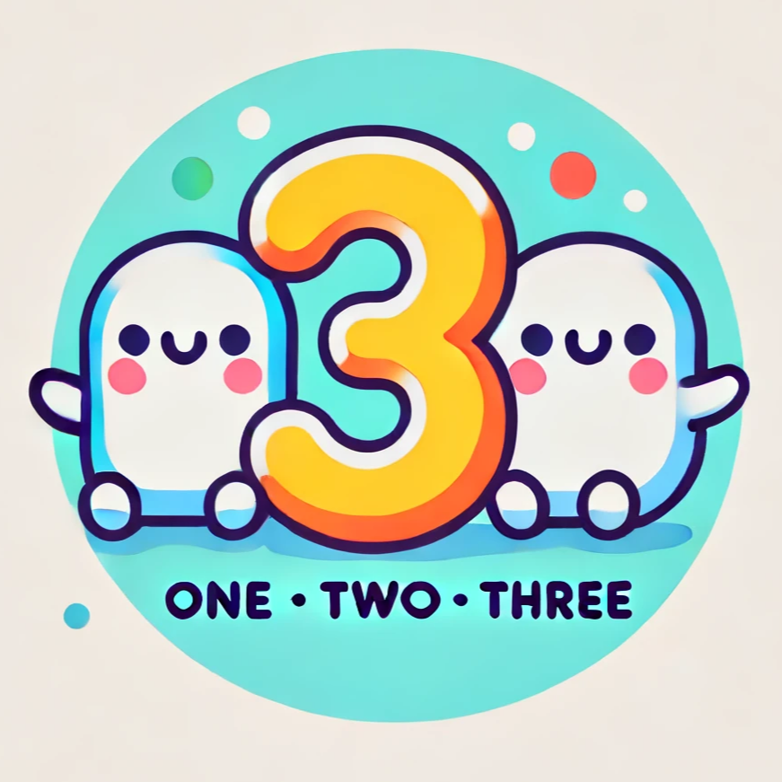
Introduction
Let’s Count
Let your kid learn to count with the story
Age: 5-7
Time: 5 min
Pages: 5
Start

Slide 3
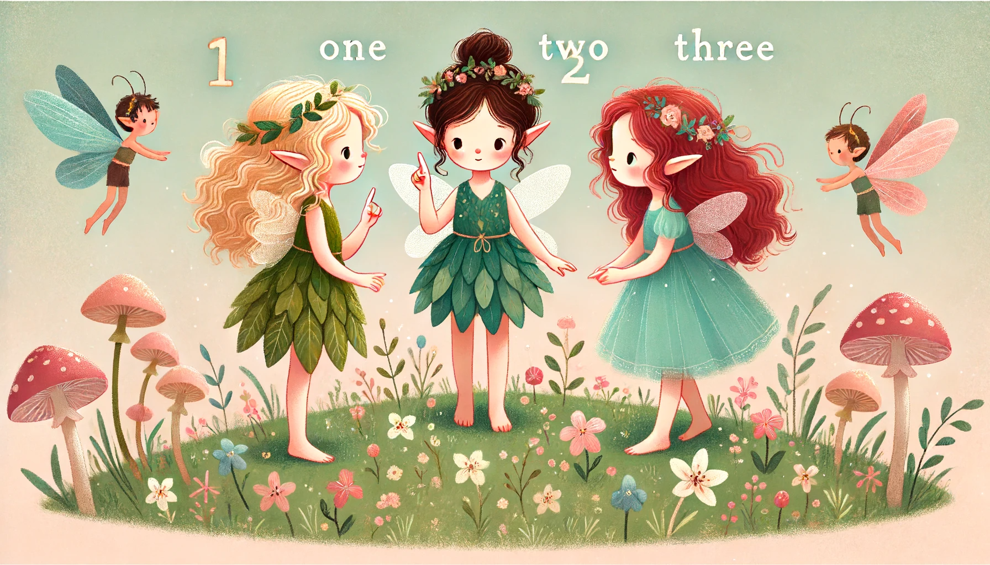
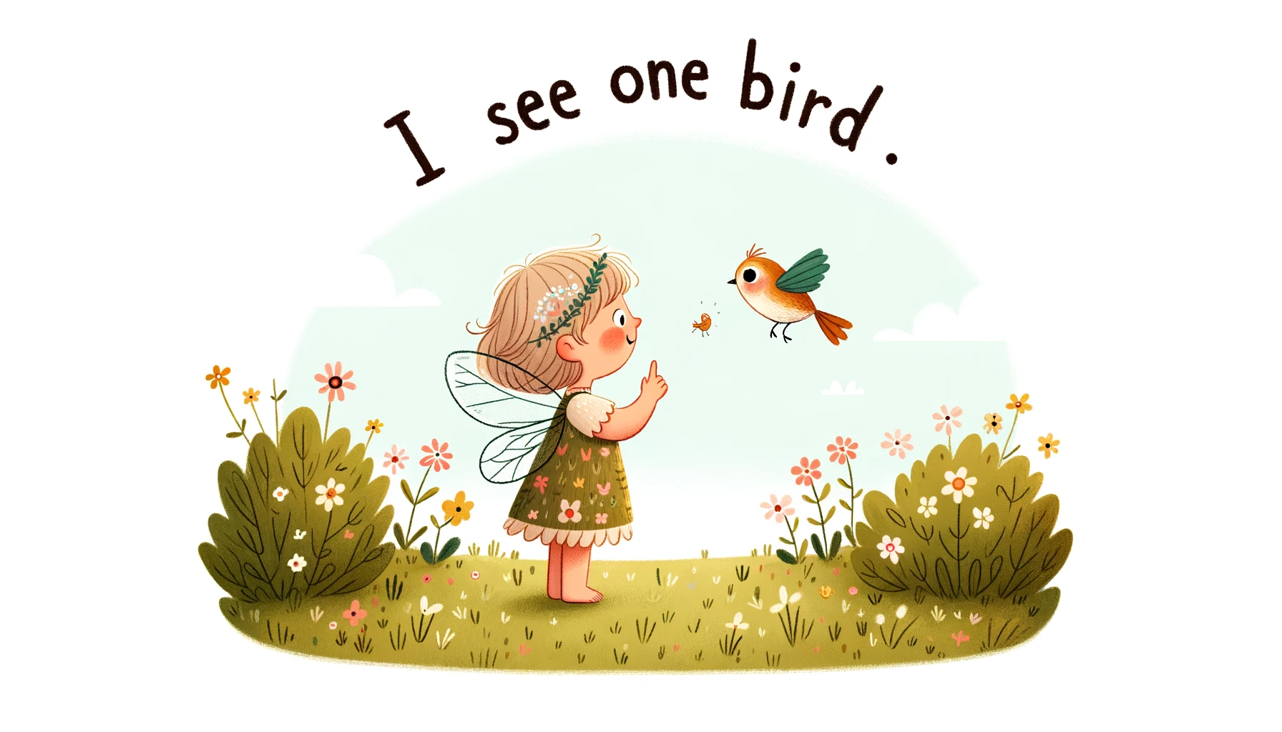
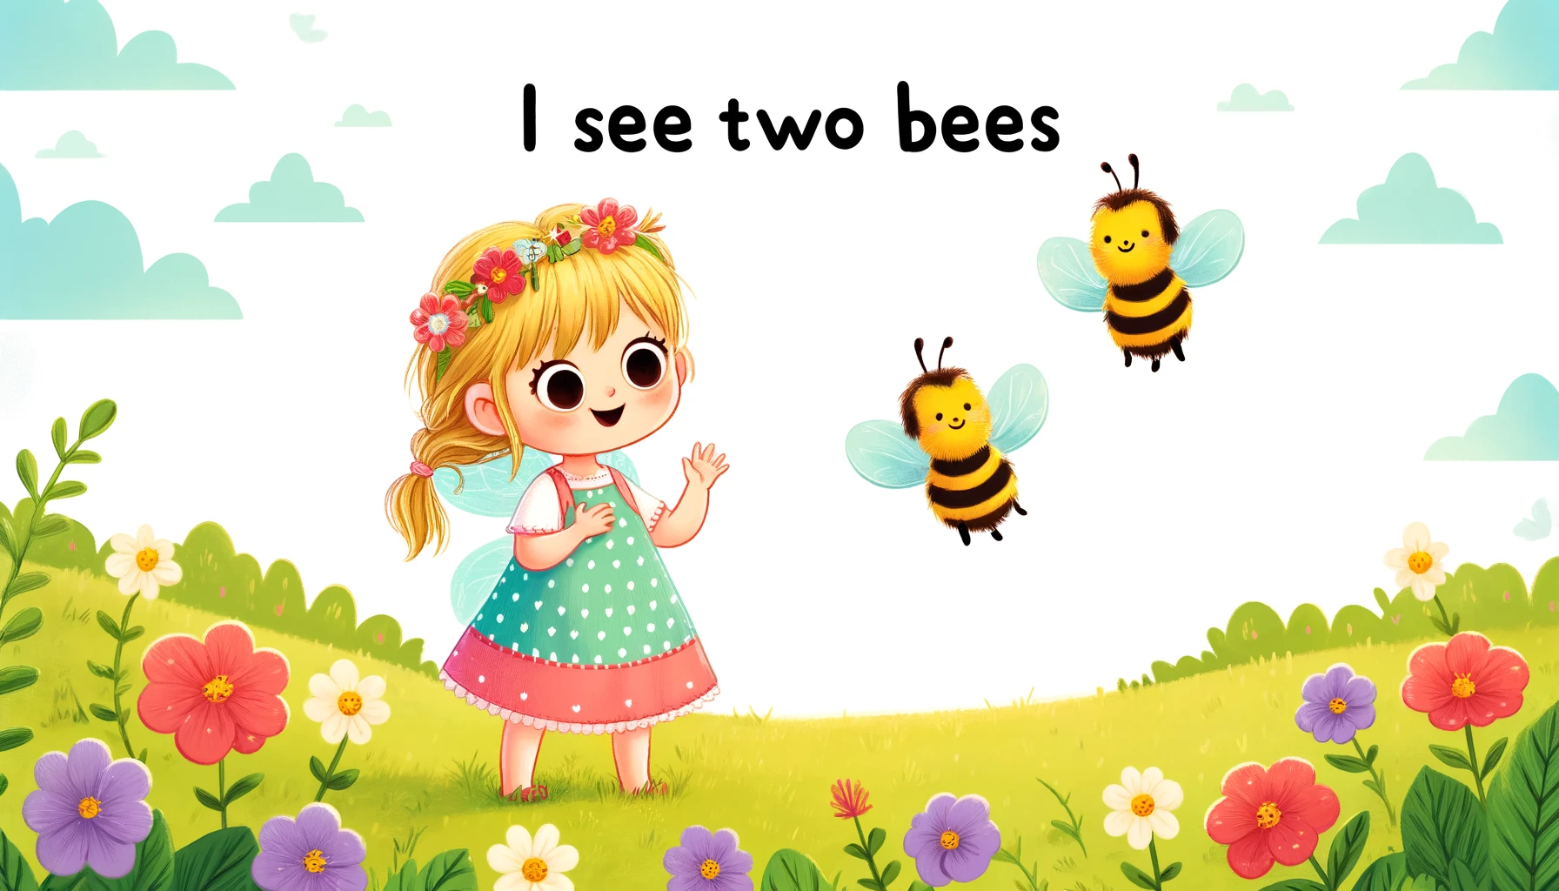
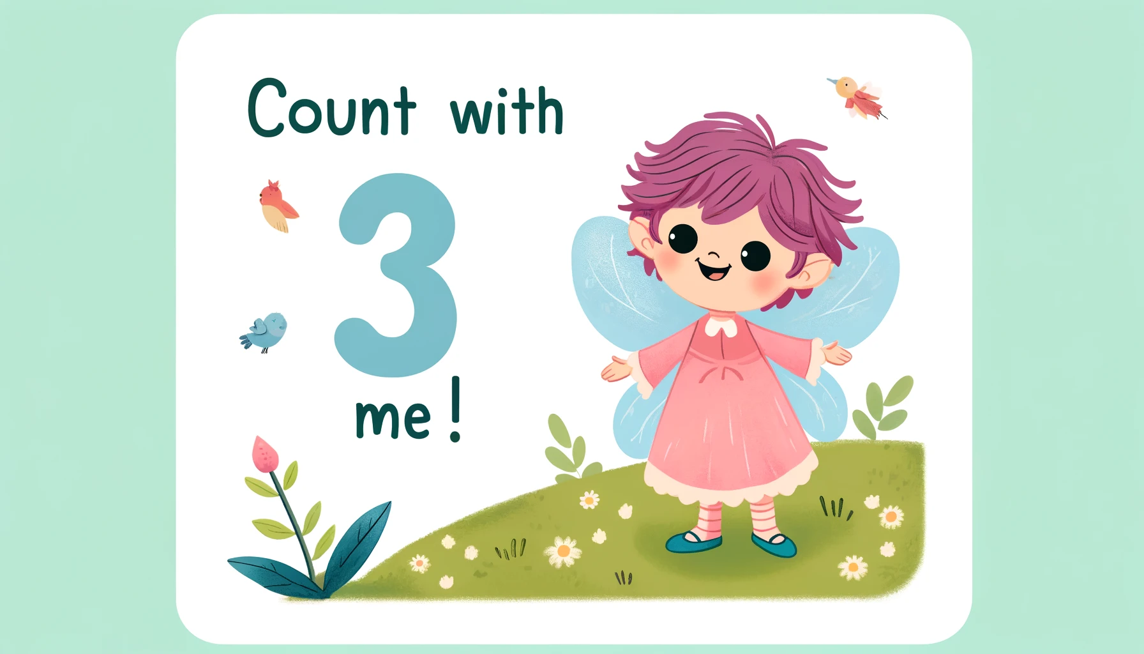
Read More!
Repeat
Next

Slide 4
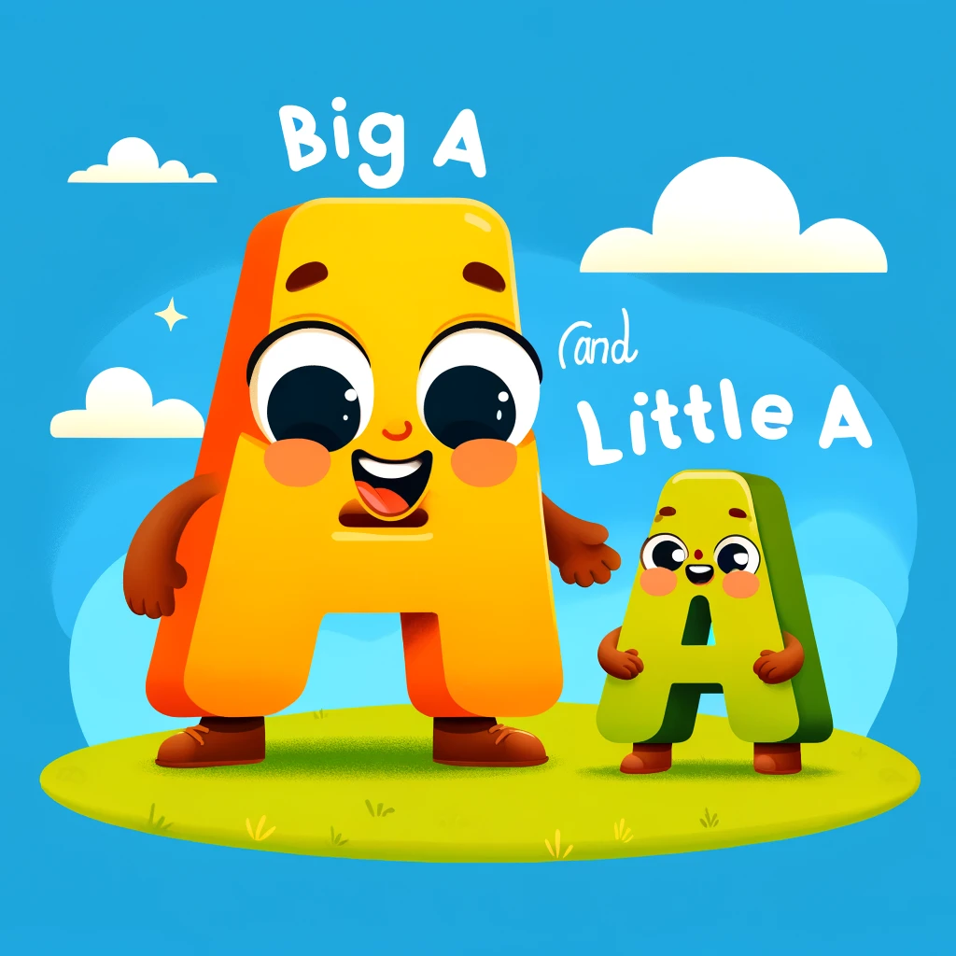
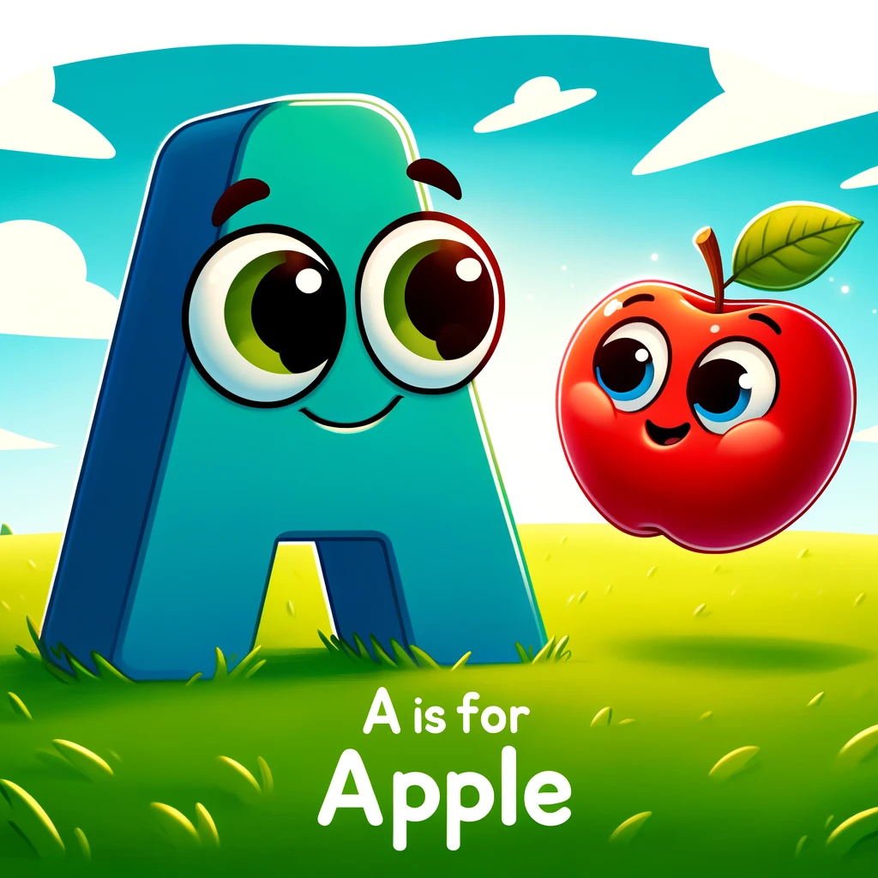
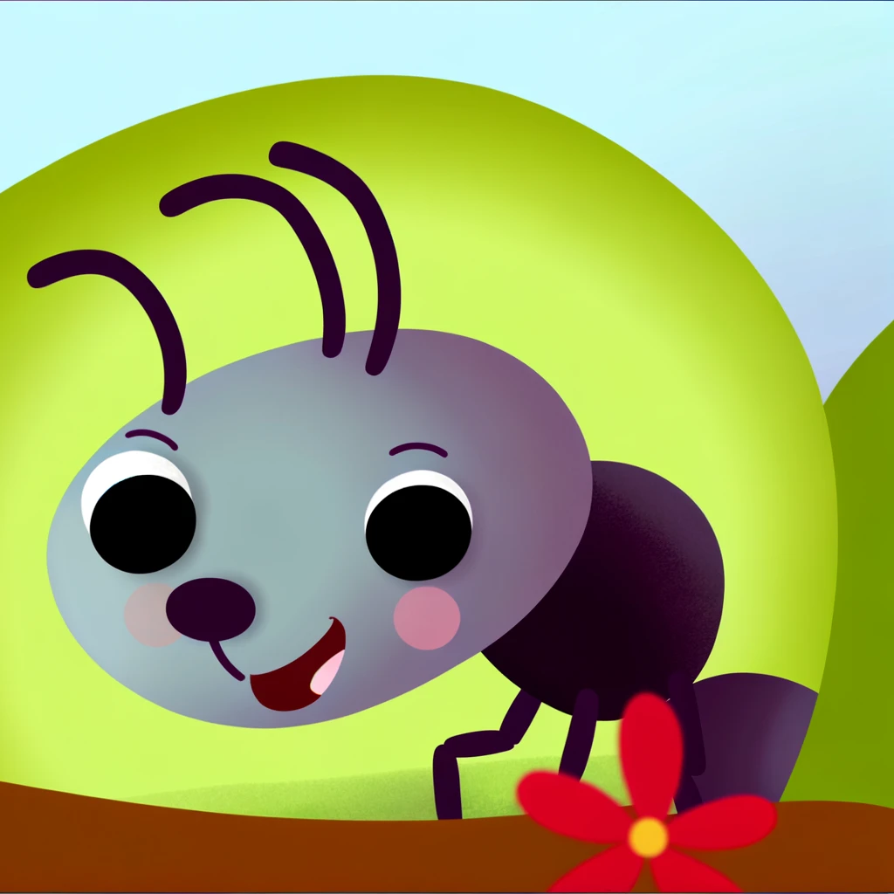
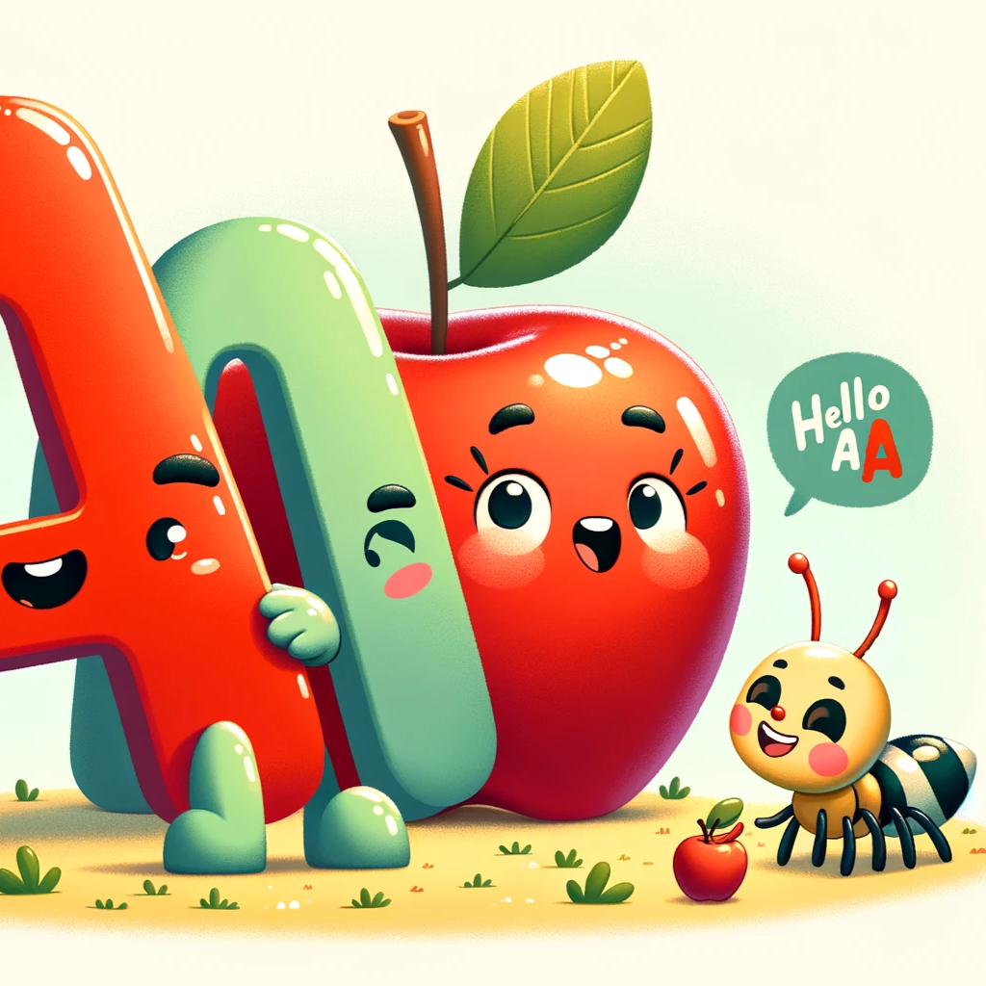
Read More!
Repeat
Next

